Slide 1
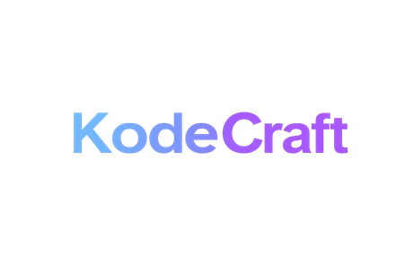
ozibook.in
Ozibook : the Placement
Solution
A dashboard for Training & Placement Officers to track placement performance, monitor recruitment trends, and analyze student selection data efficiently.
Name of Project:
Presented By:
Presented To:
Kode Craft
Parth Goel &
Naman Sharma
Ozibook Solutions

Slide 2
ozibook.in
Student
Dashboard
A Custom Student Dashboard where students can learn new skills, attend online classes, participate in hackathons, explore job and internship opportunities, and track their performance through rankings and leaderboards — all in one platform designed to support learning, growth, and career success.
Name of Project:
Presented By:
Presented To:
Kode Craft
Parth Goel &
Naman Sharma
Ozibook Solutions

Slide 3
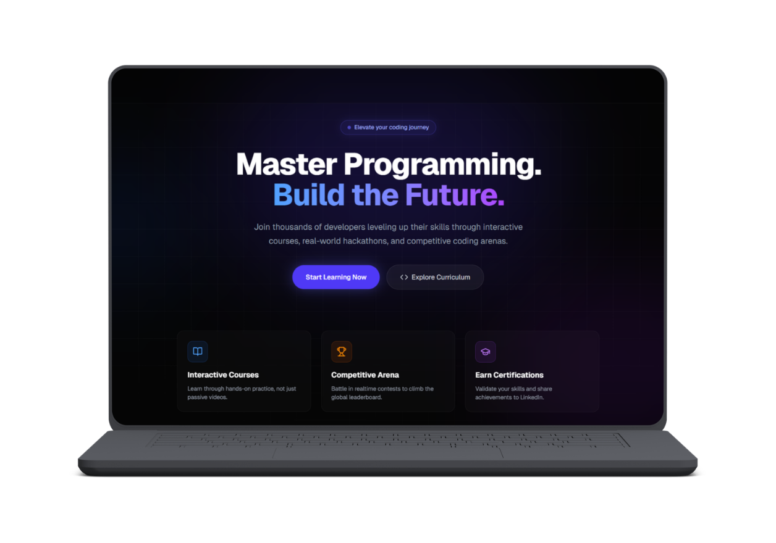
ozibook.in
Glimpses of Our Art
1. Introduction to Login page
A modern and user-friendly platform designed to make training and placements easier, faster, and more effective for students and colleges.

Slide 4
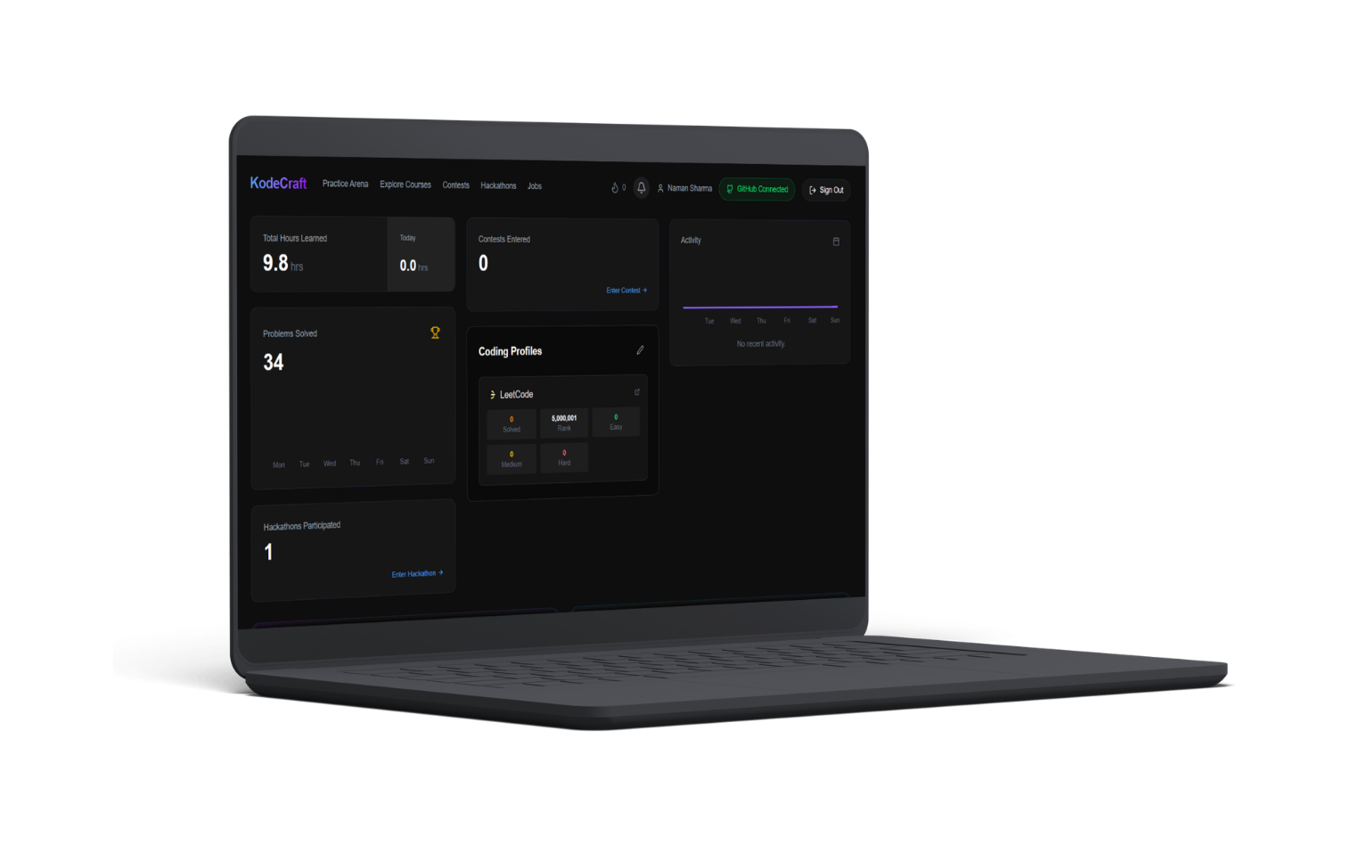
ozibook.in
Glimpses of Our Dashboard
1. Smart Student Dashboard Experience
A powerful and user-friendly dashboard designed to help students track their learning, coding progress, contests, hackathons, and placement preparation — all in one place.

Slide 5
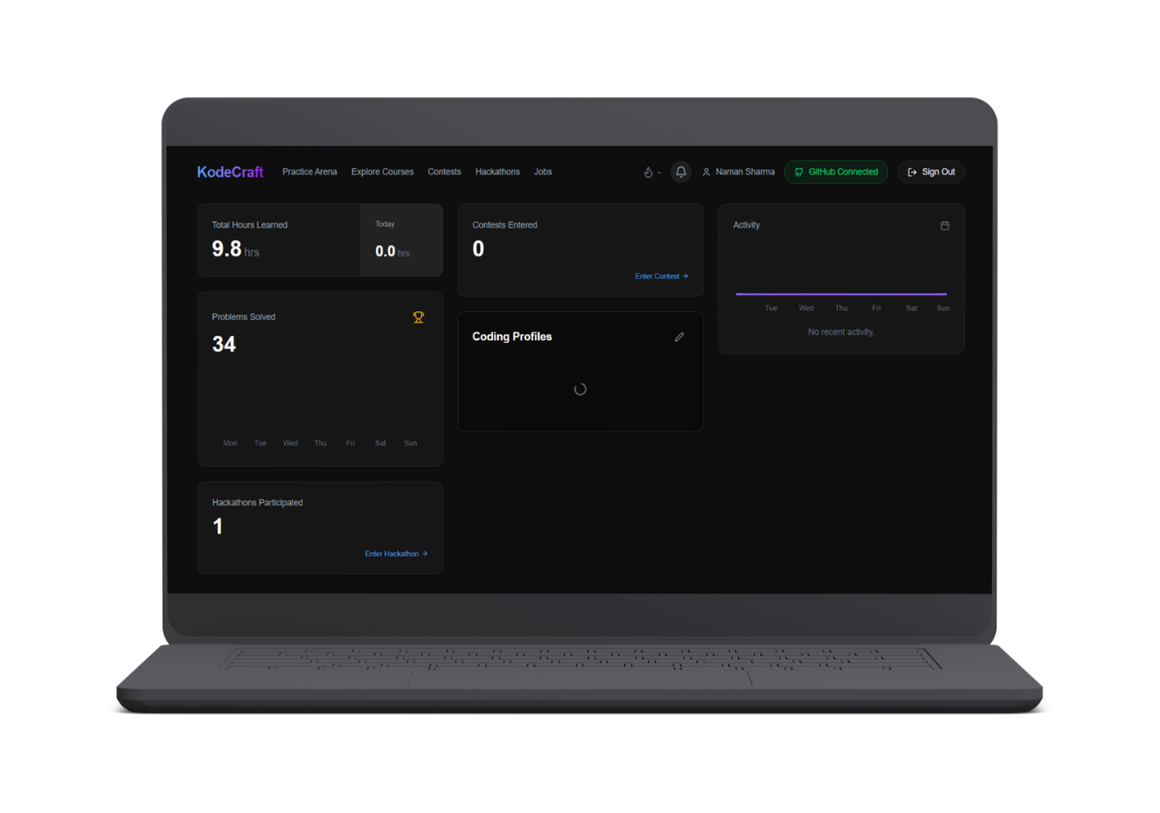
ozibook.in
Glimpses of Our Dashboard
2. Key Features of Dashboard
Real-Time Learning Progress Tracking
Coding Profile Integration
Contest & Hackathon Participation
Performance Analytics Dashboard
Career & Placement-Focused Design
Smooth and Modern User Experience

Slide 6
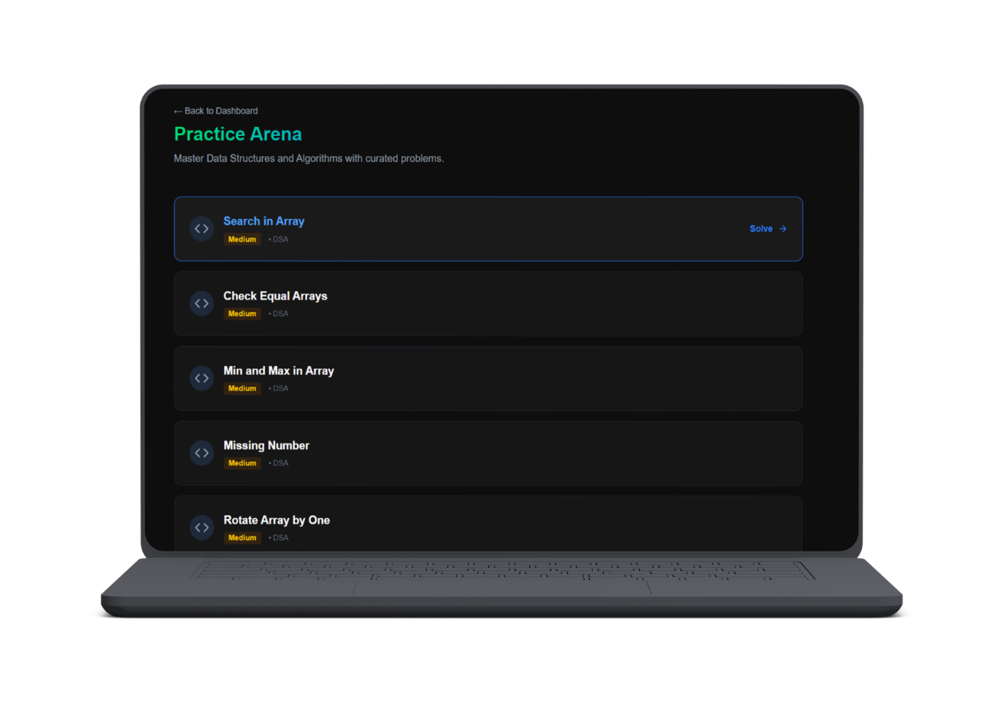
ozibook.in
Glimpses of Our Dashboard
3. AI-Enabled Practice Arena
Smarter Learning with AI Assistance
An AI-powered coding practice platform designed to help students learn faster, solve smarter, and prepare effectively for placements and technical interviews.
Key Highlights
AI-Enabled Coding Assistance
Smart Problem Recommendations
Curated DSA Practice Questions
Real Interview Preparation
Interactive and User-Friendly Experience

Slide 7
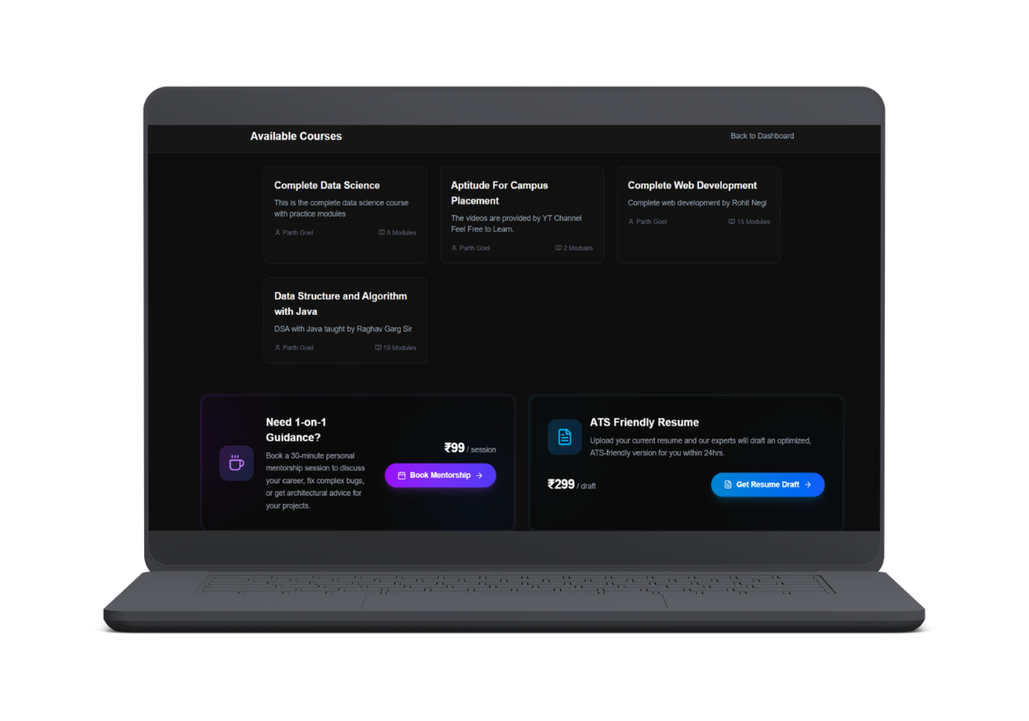
ozibook.in
Glimpses of Our Dashboard
1-on-1 Mentorship
Guidance from IITians and corporate experts for coding, interviews, and career growth.
4. Available Courses &
Career Support
Create
ATS-Friendly Resume
Industry-focused courses designed according to student needs and placement requirements, helping students build real-world skills and become career-ready.
Key Features
Placement-Oriented Courses
Web Development, DSA & Data Science
AI-Enabled Learning Experience
Student Demand-Based Training
optimized resumes for better placement opportunities and shortlisting chances.

Slide 8
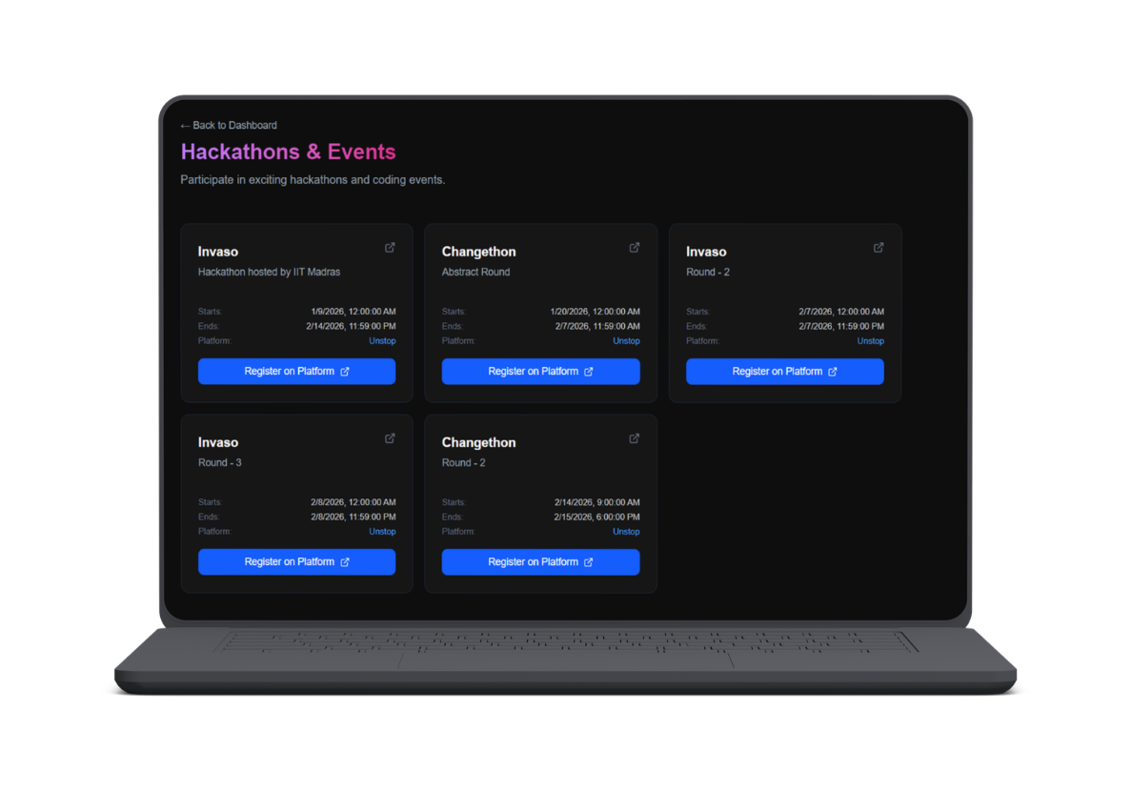
ozibook.in
Glimpses of Our Dashboard
6. Hackathons & Events
IParticipate in exciting hackathons, coding competitions, and innovation events designed to improve technical skills, teamwork, and real-world problem-solving abilities.
Key Features
National & College-Level Hackathons
Real Industry Problem Statements
Team Collaboration Experience
Innovation & Project Building
Placement-Focused Competitive Events

Slide 9
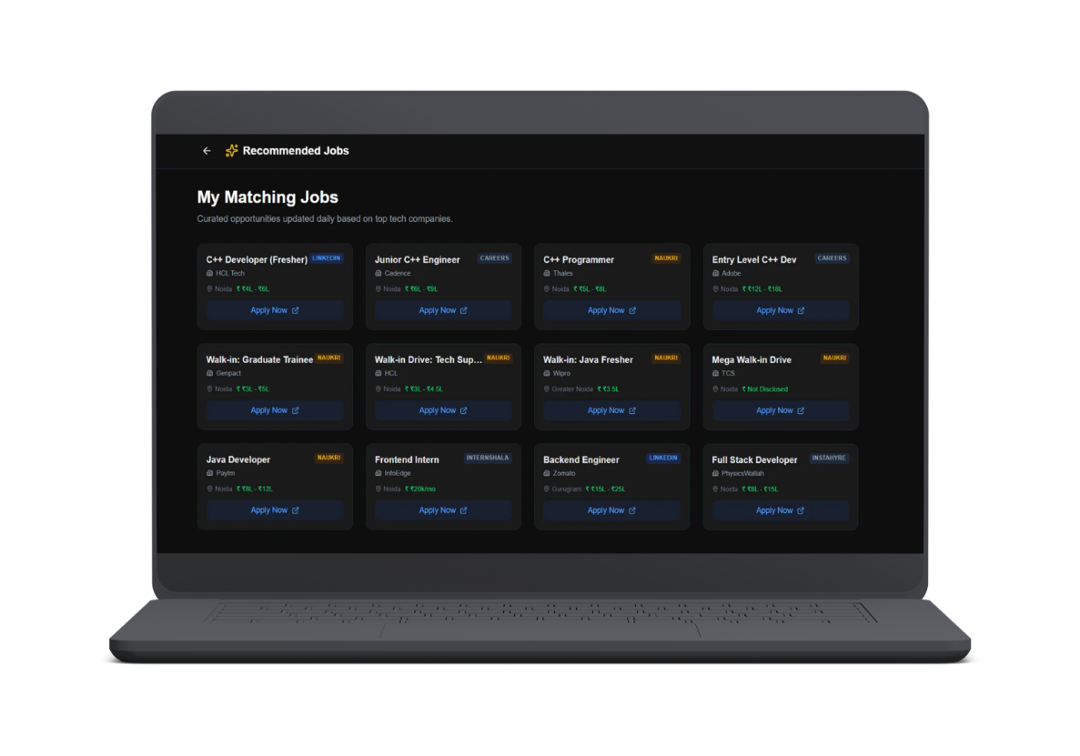
ozibook.in
Glimpses of Our Dashboard
7. Recommended Jobs Panel
IPAn intelligent job recommendation system designed to connect students with relevant placement opportunities based on their skills, learning progress, and career interests.
Key Features
AI-Based Job Recommendations
Placement-Focused Opportunities
Skill & Profile Matching
Easy Job Application Process
Internship & Full-Time Opportunities
User-Friendly Dashboard Experience
Purpose
Helping students discover the right career opportunities faster and improve their placement success rate.

Slide 10
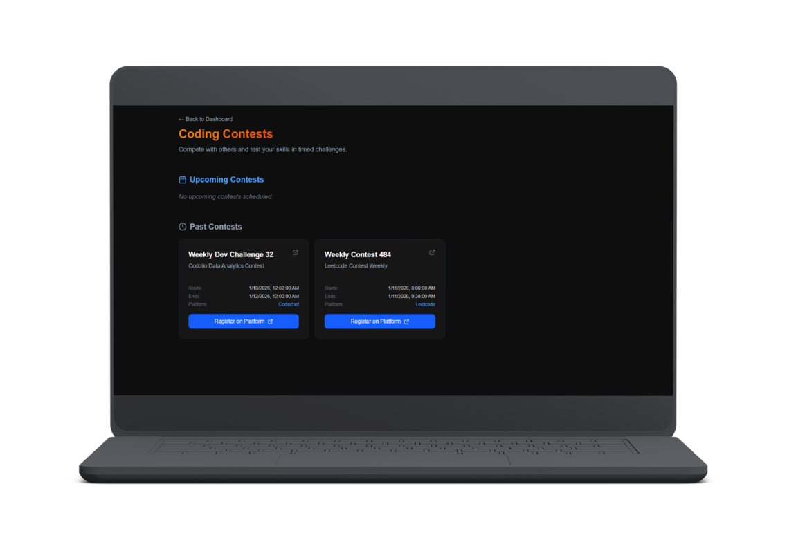
ozibook.in
Glimpses of Our Dashboard
1-on-1 Mentorship
Guidance from IITians and corporate experts for coding, interviews, and career growth.
5. Coding Contests
Create
ATS-Friendly Resume
Industry-focused courses designed according to student needs and placement requirements, helping students build real-world skills and become career-ready.
Key Features
Placement-Oriented Courses
Web Development, DSA & Data Science
AI-Enabled Learning Experience
Student Demand-Based Training
optimized resumes for better placement opportunities and shortlisting chances.

Slide 11
ozibook.in
TPO’s
Dashboard
A centralized dashboard for Training & Placement Officers to manage placement activities efficiently. The panel allows TPOs to add new job opportunities, set eligibility criteria, track student engagement, monitor approvals, and manage coordination groups in real time.
Name of Project:
Presented By:
Presented To:
Kode Craft
Parth Goel &
Naman Sharma
Ozibook Solutions

Slide 12
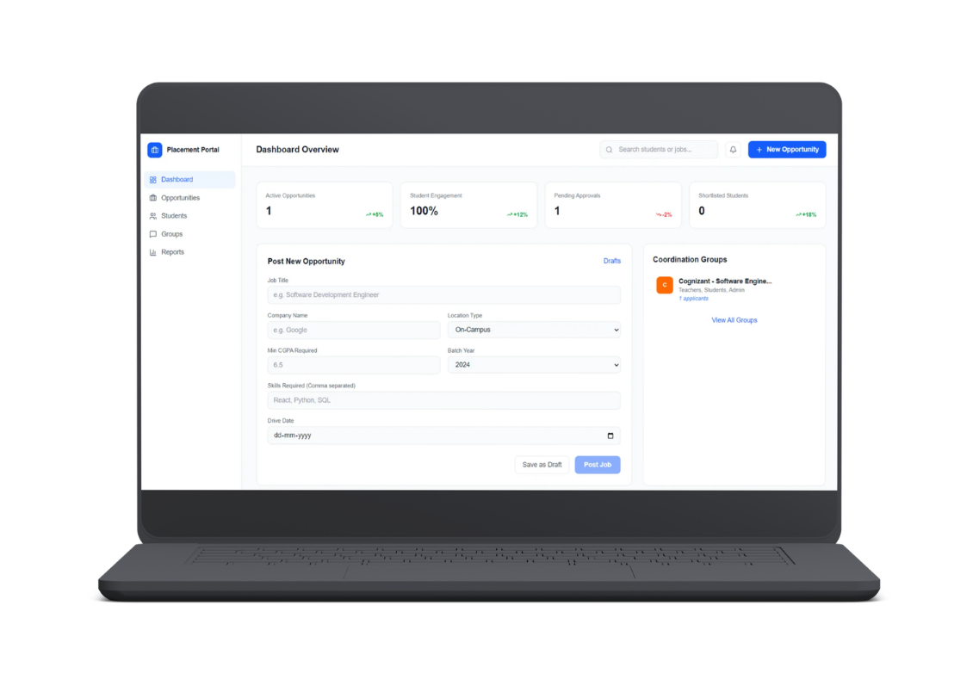
ozibook.in
Glimpses of Our TPO’s Dashboard
1. TPO Dashboard Panel
Features
Add New Opportunities
Manage Student Applications
Track Placement Activities
Monitor Engagement & Approvals
Coordinate Recruitment Drives
Generate Placement Reports
Benefits
Faster Placement Management
Centralized Recruitment Process
Improved Student Coordination
Real-Time Analytics & Tracking

Slide 13
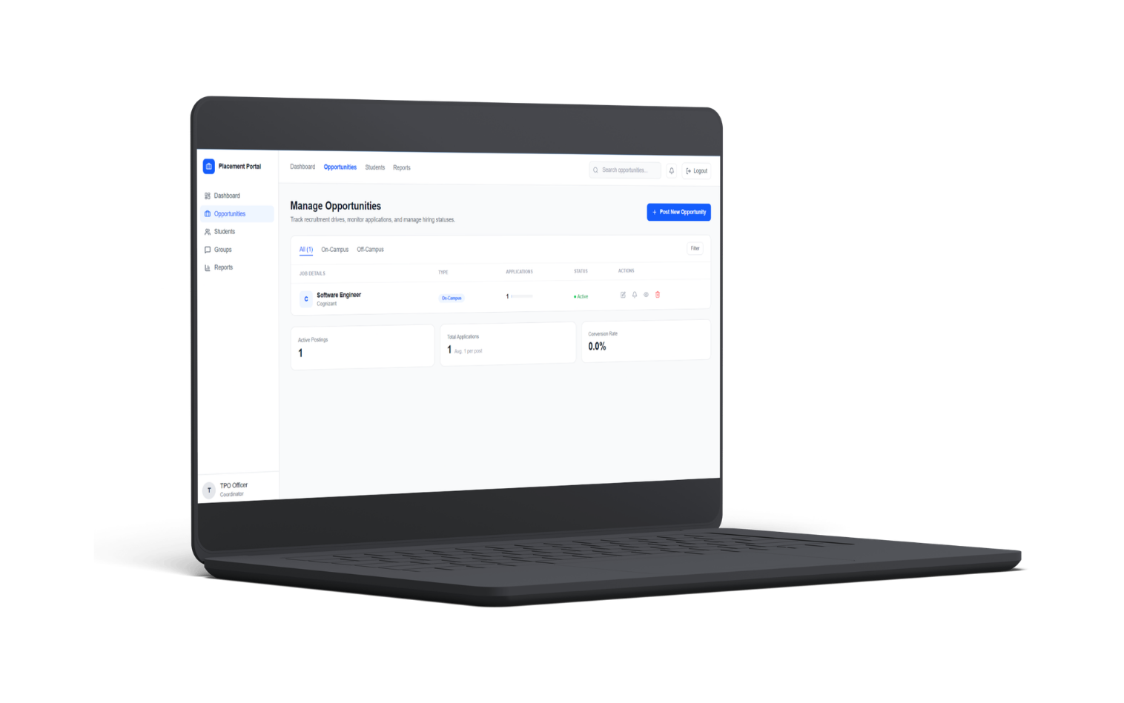
ozibook.in
Glimpses of Our Dashboard
2. Opportunity Management Panel
This panel enables Training & Placement Officers to manage and monitor all placement opportunities from a centralized dashboard. TPOs can track applications, manage hiring status, filter on-campus and off-campus drives, and oversee recruitment activities efficiently.
Features
Manage Job Opportunities
Track Student Applications
Monitor Hiring Status
Filter On-Campus & Off-Campus Drives
Edit, View & Delete Postings

Slide 14
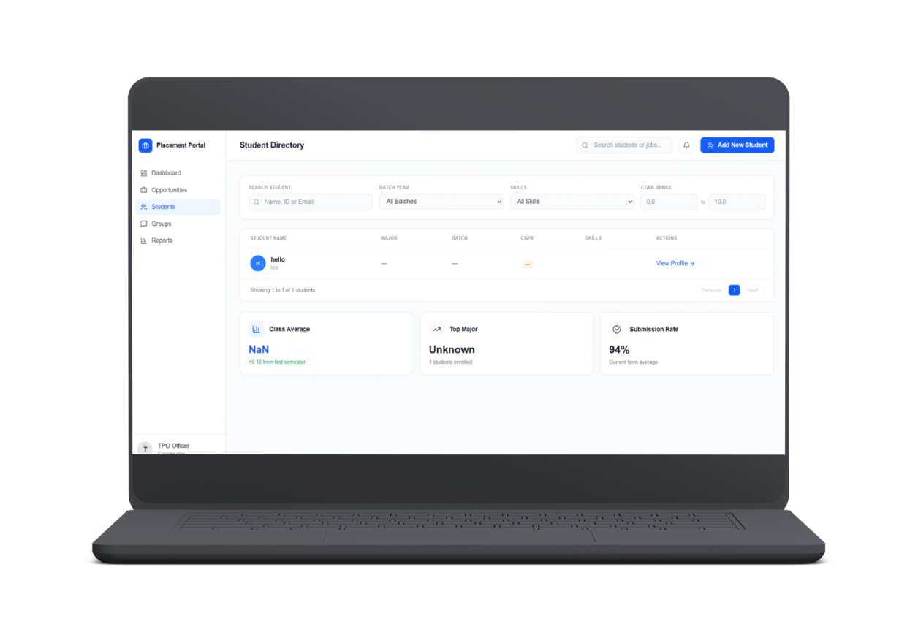
ozibook.in
Glimpses of Our Dashboard
3. Student Directory Panel
A centralized panel for Training & Placement Officers to manage student records, track academic performance, and monitor placement-related activities efficiently.
Features
Search & Filter Students
Batch and Skill-Based Sorting
CGPA Tracking
Student Profile Viewing
Performance Analytics
Benefits
aster Student Management
Real-Time Insights

Slide 15
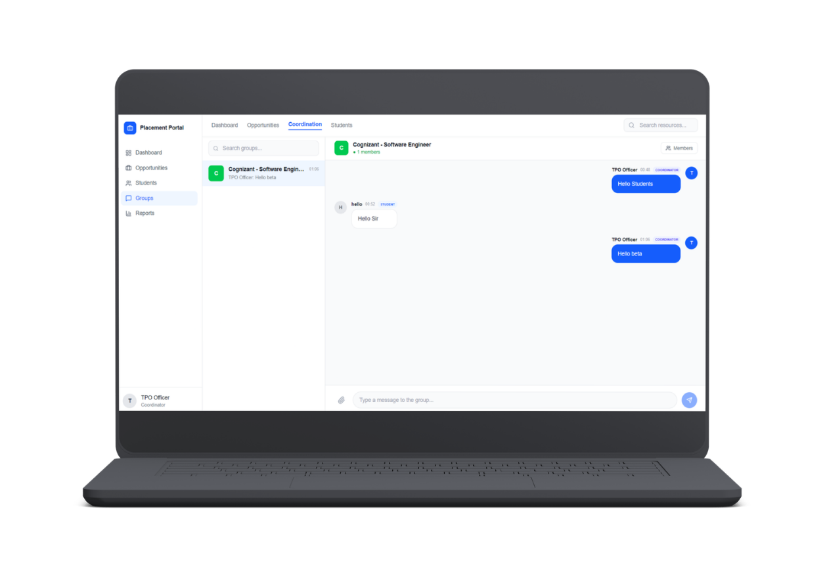
ozibook.in
Glimpses of Our Dashboard
4. Communication & Collaboration System
A centralized communication panel for Training & Placement Officers and students to coordinate placement activities, share updates, and manage group discussions efficiently.
Features
Real-Time Messaging
Group Discussions
Student & TPO Coordination
Instant Notifications
Benefits
Faster Communication
Better Coordination
Smooth Placement Workflow

Slide 16
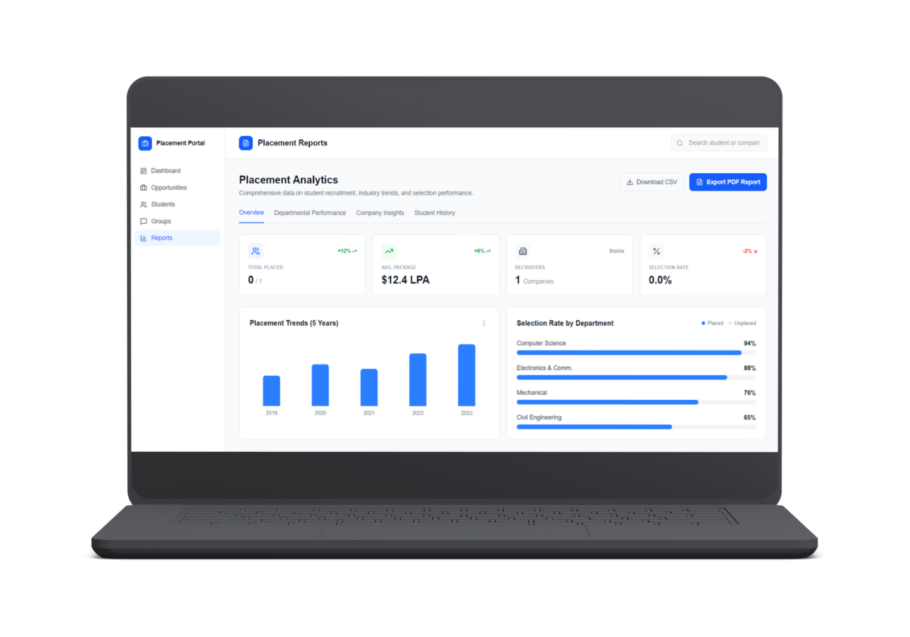
ozibook.in
Glimpses of Our Dashboard
5. Placement Analytics System
A dashboard for Training & Placement Officers to track placement performance, monitor recruitment trends, and analyze student selection data efficiently.
Features
Placement Analytics
Department Insights
Selection Rate Tracking
Report Export System
CSV & PDF Report Export
Benefits
Better Analysis
Easy Report Management
Real-Time Insights

Slide 17
ozibook.in
Why Choose Ozibook.in ?

Slide 18
ozibook.in
Why Choose Ozibook.in?
11. Coding Competitions & Skill Contests
12. In-College Hackathon Assessments
13. End-to-End Placement Assistance
14. Daily Live Interactive Classes
15. Weekend Sessions with Industry Experts &
IITians
16. Daily Mentor-Led Doubt Solving
17. Monthly Offline Performance Assessments
18. Real-Time Practice Mode During Live Classes
19. Automatic GitHub Code Integration
20. Industry-Focused Career Programs (Data Science, DSA, Web Development & More)
1. Dedicated Dashboards for TPOs, Students & Management
2. Comprehensive Recorded Lecture Library
3. AI-Powered Assessments & Smart Solutions
4. 24×7 AI Learning Support
5. Advanced DSA Practice Arena
6. AI-Driven Interview Preparation Courses
7. Integrated Tests & Assignments
8. Placement-Oriented MCQ Practice System
9. Expert-Led Mock Interviews
10. National & Campus Hackathons

Slide 19
ozibook.in
Let's Work Together!
Thank you for exploring our Smart Placement Management System.
Our platform is designed to simplify placement operations, improve student coordination, and enhance recruitment management through a centralized digital solution.

